Slide 1

UNIVERSITY ADMISSION PREDICTION

Slide 2

Presenting Our Idea:
Our goal here would be to predict the “Chance of Admit” based on the different parameters that are provided in the dataset.

Slide 3
Table Of Contents
Introduction
Dependencies
Datasets-Import
Feature Engineering
Model Building
WEB via streamlit
Conclusion

Slide 4
INTRODUCTION:
We will achieve this goal by using the Linear Regression model.
To create the Linear Regression model we will use python.
It is a statistical method which is used to obtain formulas to predict the values of one variables from another where there is a relationship between the 2 variables.
Both the variables are named as below:
y : Dependent variable
x : Independent variable

Slide 5
Dependencies
scikit-learn
seaborn
numpy
pandas
Matplotlib
Pickle
Streamlit

Slide 6
Datasets:
The columns in the dataset are Serial Number, GRE score, TOEFL score, University Rating, SOP, LOR, CGPA, Research and Chance of Admit.

Slide 7
Heatmap:
The heatmap is a way of representing the data in a 2-dimensional form. The data values are represented as colors in the graph. The goal of the heatmap is to provide a colored visual summary of information.
Code:
f,ax=plt.subplots(figsize = (10,10))
sns.heatmap(df.corr(method="pearson"),annot=True,fmt ='.2g',square=True,cmap='coolwarm',cbar=False,ax=ax)

Slide 8
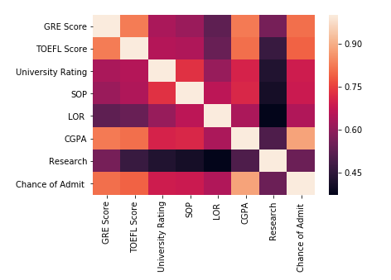
Output:

Slide 9
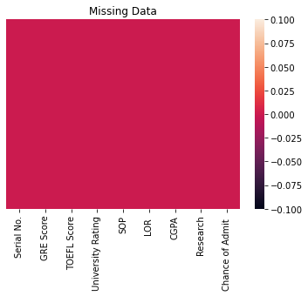
HEATMAP for Checking Null Value

Slide 10
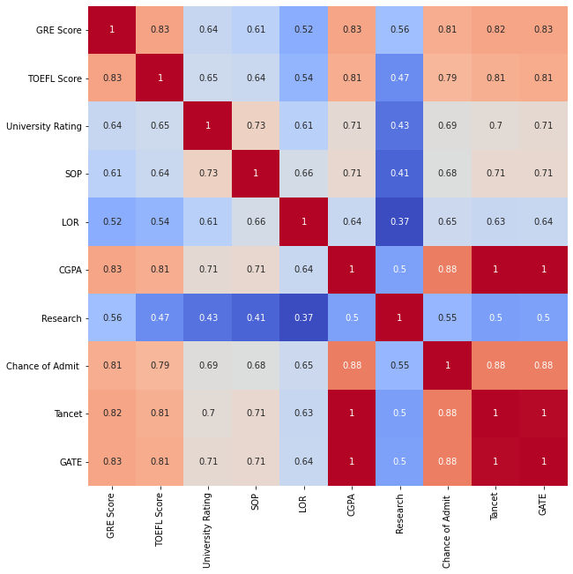
HEATMAP For checking CO-relation

Slide 11
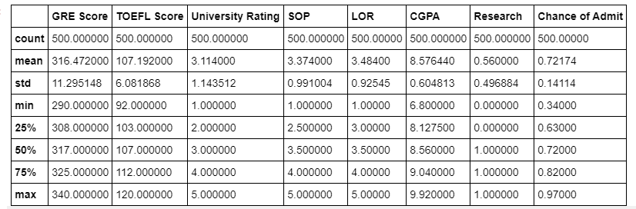
Describe:
describe() method computes a summary of statistics like count, mean, standard deviation, min, max and quartile values pertaining to the DataFrame columns.

Slide 12
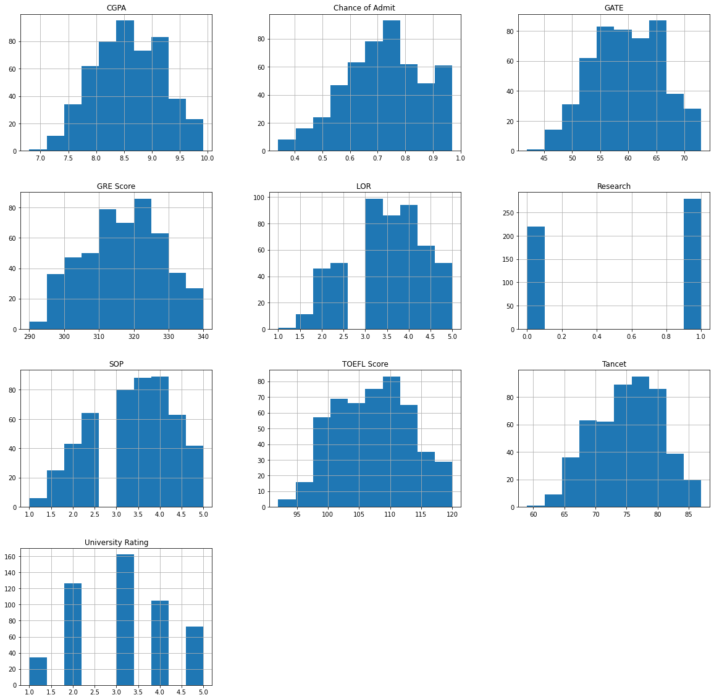
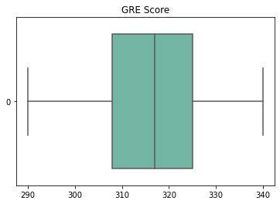
OUTLIER CHECKING USING BOX PLOT AND HIST PLOT

Slide 13
SPLITTING and REGRESSION
X_train,X_test,y_train,y_test=train_test_split(X,y,test_size=0.30,random_state=1)
regressor.fit(X_train,y_train)
y_predict=regressor.predict(X_test)
I split the data into two different sets, one for the independent features — x, and one for the dependent variable — y (which is the last column). Next I split the dataset x into two separate sets — xTrain and xTest. Similarly, I splitted the dataset y into two sets as well — yTrain and yTest. The training set has 75% of data while test set has 25% of it.

Slide 14

Sklearn model:
from sklearn.metrics import mean_squared_error
mean_squared_error(y_test,y_predict)
Mean_squared_error of the model is: 0.004274138176893162

Slide 15
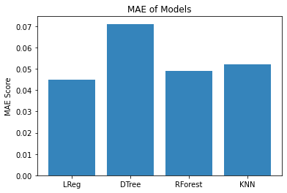
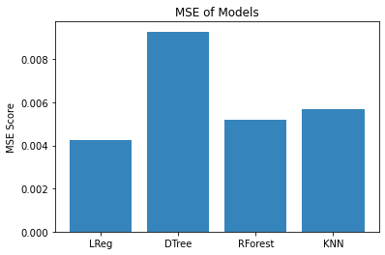
Comparative Analysis

Slide 16
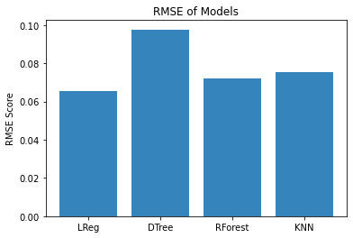
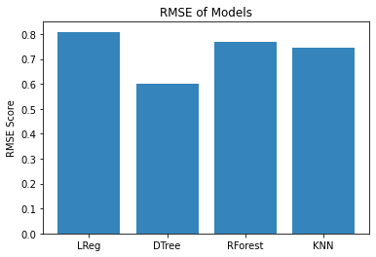
BY comparative analysis the model
Decision Tree Regressor is Finalised

Slide 17

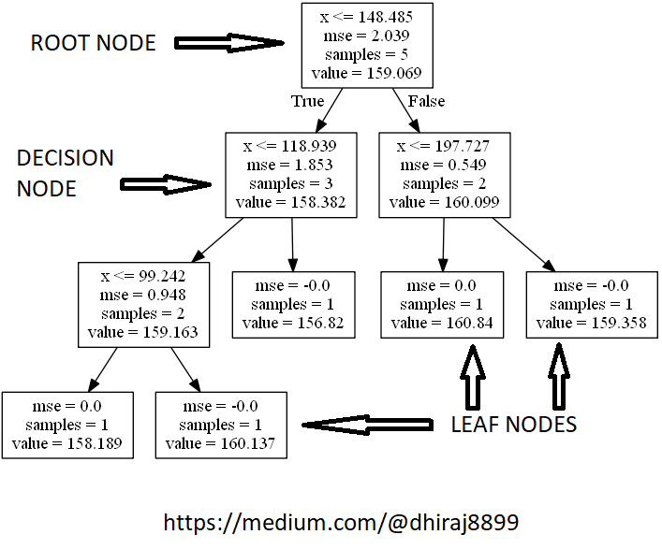
Decision Tree Regressor

Slide 18
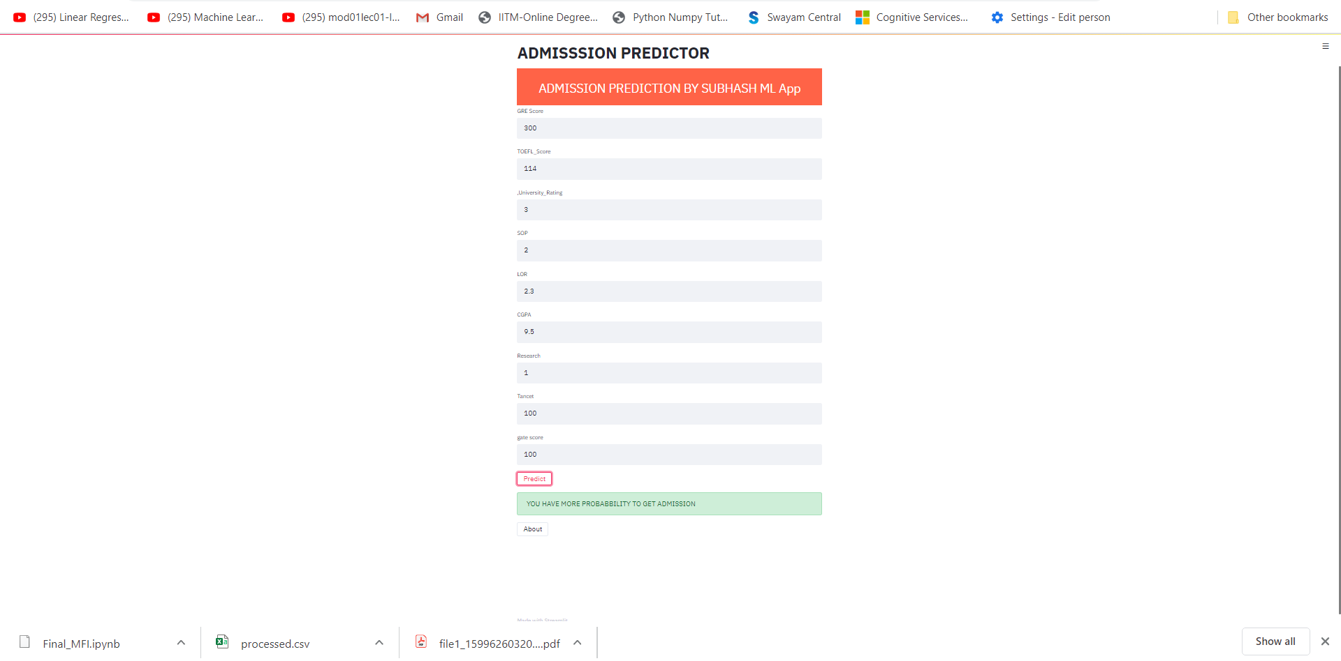
Streamlit Desktop View

Slide 19
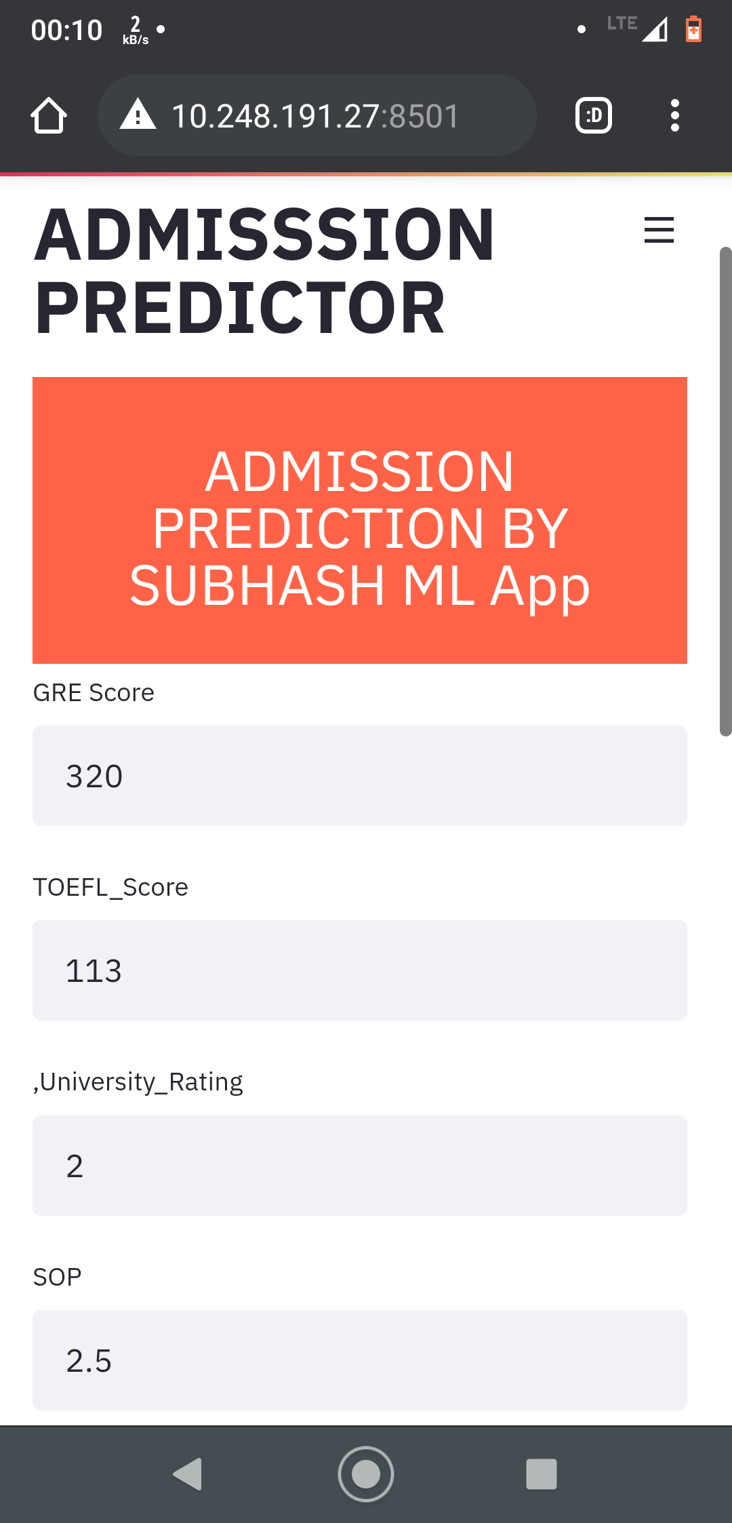
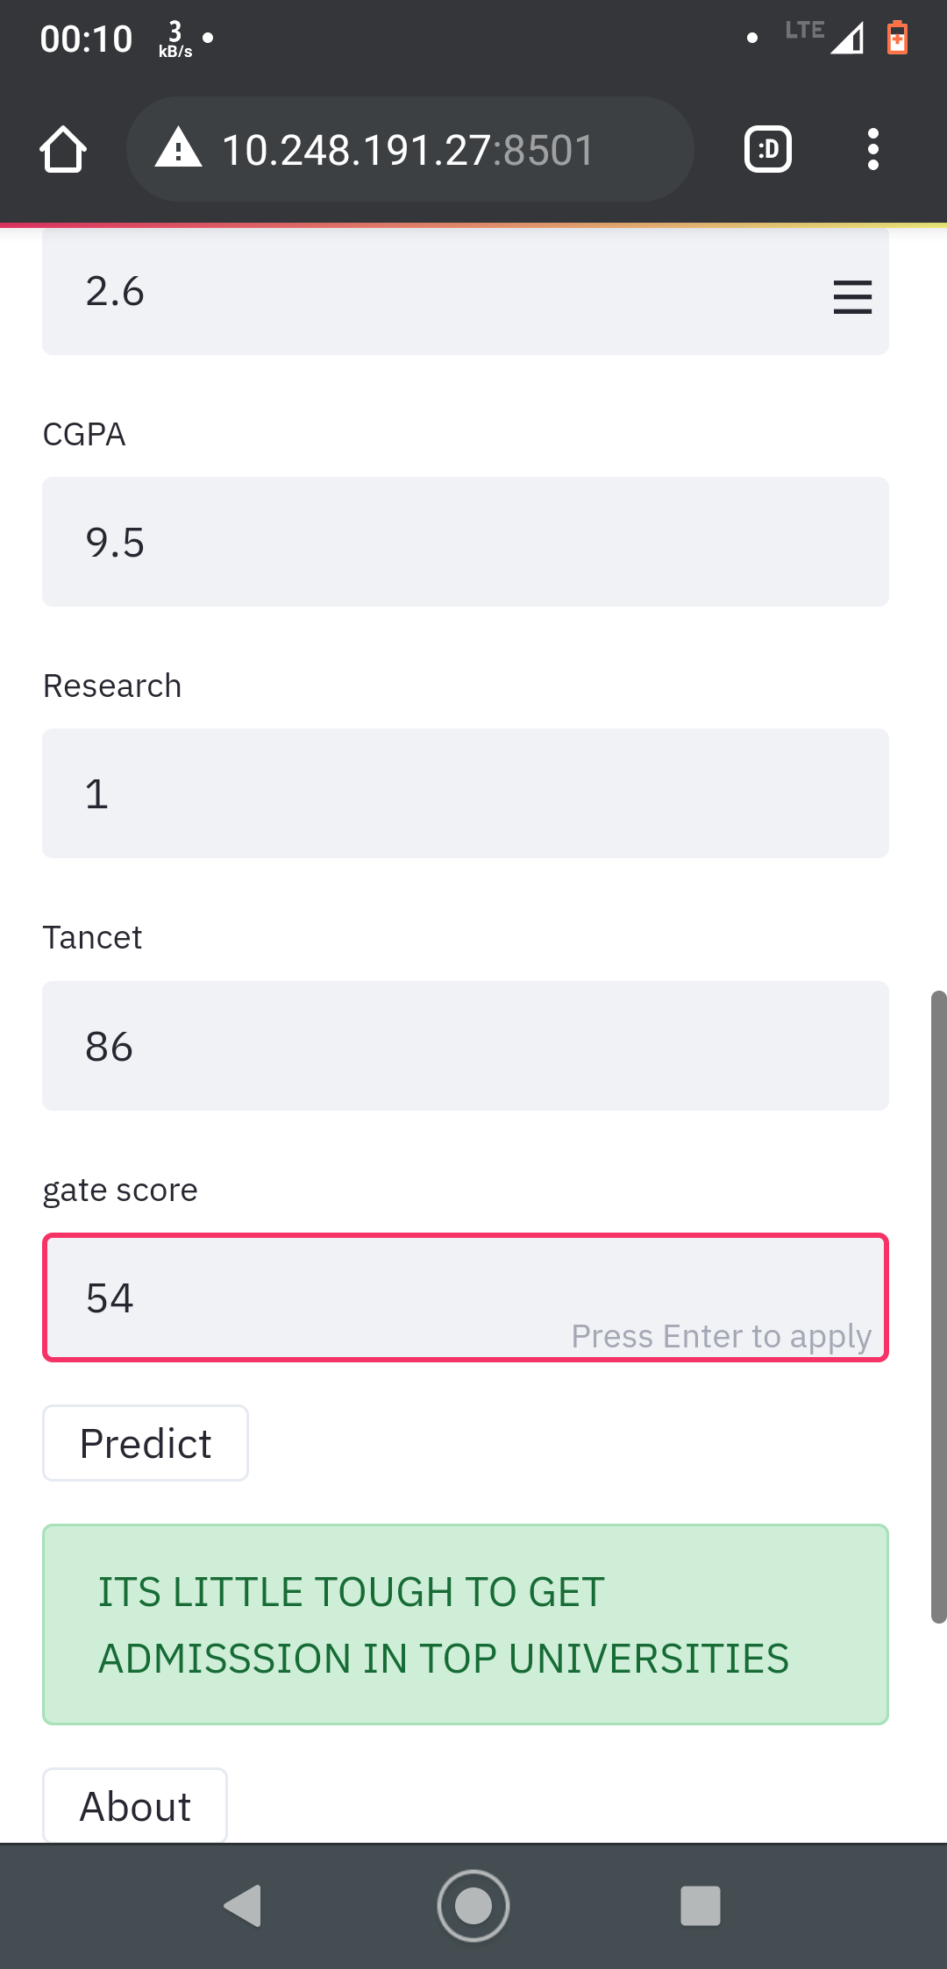
Streamlit Mobile View

Slide 20
Conclusions
As a quick summary, I used Decision Tree regression algorithm to predict the chance for graduate admission. This could be of great help for students preparing for their higher studies.

